Slide 1
AI BOX introduction
202112 V2

Slide 2
Challenges in CCTV industry
01
02
AI BOX solution
CONTENT
Highlights
03
Application
04
Q&A
05

Slide 3
01
Challenges in CCTV industry

Slide 4
Challenges in CCTV industry
No intelligent function,
All the obtaining of information depends on manual work only.
Due to limited security guards, human response and processing efficiency, we cannot fully monitor all locations.

Slide 5
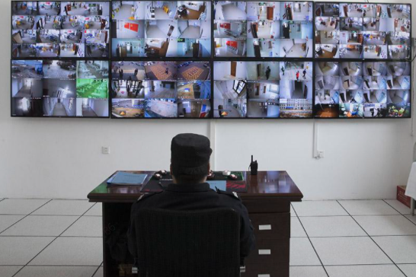
Challenges in CCTV industry
Human monitoring is not reliable for all the conditions.
According to a survey, after staring at a screen for 22 minutes, security guards ignore 95% of the information on the screen.
Watching live video streams can make people tired and unfocused, it’s hard to detect security threats and raise real-time alarms.

Slide 6
Challenges in CCTV industry
Traditional intelligence solutions cannot meet all the requirements.
Advanced function, such as face recognition is available in high-end products.
Special requirement cannot be met. E.g. work clothes detection.

Slide 7
Challenges in CCTV industry
Traditional intelligence solutions are not flexible
Traditional servers got more functions, but they are not suitable for small scenarios.
They need to be placed in the data center and cost more.

Slide 8
02
AI BOX solution

Slide 9
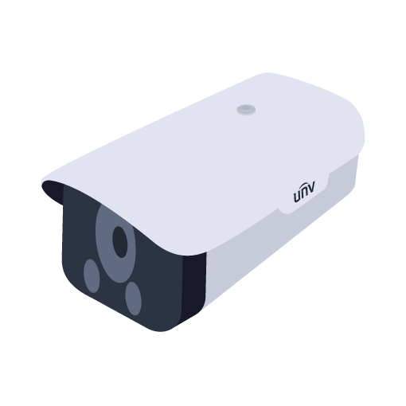
Overview
AI BOX is an intelligent extension of CCTV system.
UNV AI BOX is an intelligent edge computing server that can analyze IPC video stream and enable face recognition and behavior analysis. With built-in deep intelligent learning algorithms, it can meet intelligent function demand.
AI BOX
Input video stream
Output information
Intelligent analysis
Business management

Slide 10
Face recognition
Multiple attributes
Face recognition is able to realize face capture, feature analysis and real-time comparison in a variety of environments to achieve black-and-white list control.
comparison
gender
glasses
age
Self-adapting recognition
To ensure the accuracy, the sampling points were automatically collected and tracked even there are changes in age, wearing masks, bangs, squinting and closing eyes and other facial behaviors.

Slide 11
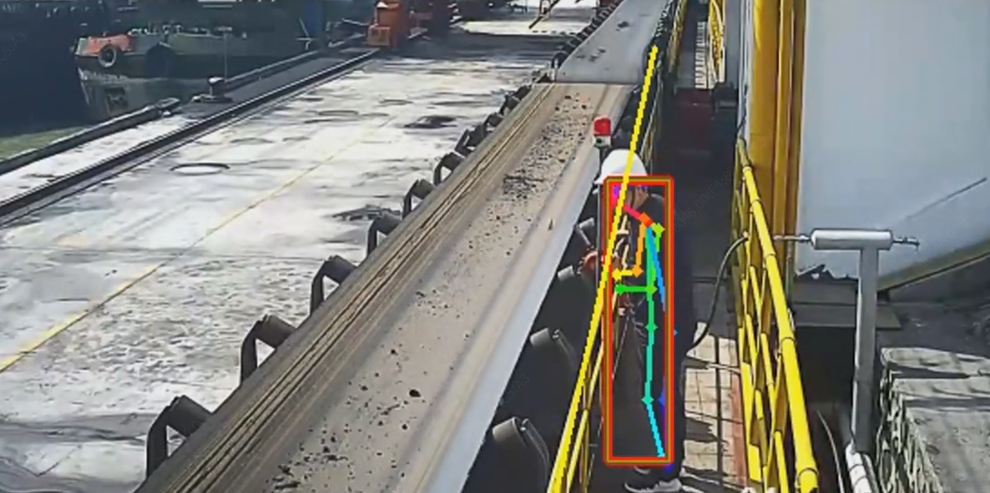
Behavior analysis
Skeleton-based action
recognition
Identify the human skeleton structure in the video and recognize the behavior based on the skeleton structure.
Support mainstream algorithms
It has 12 behavior algorithms. Specific algorithms can be chosen according to the scenario.
New behavior algorithms can be developed depending on specific requirements after evaluation.

Slide 12
Behavior analysis
Off duty detection
No helmet detection
No work clothes
detection
Smoking detection
Calling detection
No face mask detection
Fire detection
Long stay detection
Perimeter
People counting
Heat map
Falling detection

Slide 13
03
Product highlights

Slide 14
Product highlights
Different intelligence for every channel
Multiple front end access, simple adaption
Lightweight design,
easy deployment
Built-in Web client
application

Slide 15
Different intelligence for every channel
Every channel supports more than one intelligent function at the same time.
Different channels can load different behavior analysis.
Channel 1
Channel 2
Channel 3
At present, face recognition and behavior analysis cannot be enabled at the same time in one AI BOX (which can be optimized in January, 2022)

Slide 16
Multiple front end access, simple adaption
4/8
4 and 8 channel models can be selected, according to different AI computing capabilities demand.
Accessing IPC with RTSP or ONVIF protocol.
IPC
AI Box

Slide 17
Lightweight design, easy deployment
Intelligent modification for the common front-end IPC can be carried out without changing the original video surveillance network, which saves both money and time.
Bring intelligence into play - even with an existing system.
AI BOX
Intelligent empowerment
IPC
NVR
VMS

Slide 18
Advantages
Better intelligence leads to more possibilities
 | AI BOX | Traditional solutions (IPC+NVR) | Traditional solutions (centralized server)
Intelligent functions | More | Less | More
Flexibility | Flexible | Fixed | Fixed
Application scenario | Both small and large scale solution | Small | Large scale
Cost | Economical. Intelligent upgrade can be realized without changing the original video surveillance network. | The original video surveillance system need to be replaced. The cost of devices, installation and wiring construction would be very high. | It is complex to install and difficult to deploy, and the cost would be very high at the same time.

Slide 19
04
Application

Slide 20
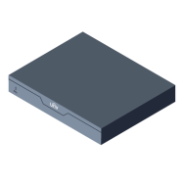
Typical application
IPC
Monitor
Target appears
IPC
Video stream
Upload Network Port
IPC
UNV NVR
AI Box Intelligent analysis
Web
Management on the web, display and record retrieval.

Slide 21
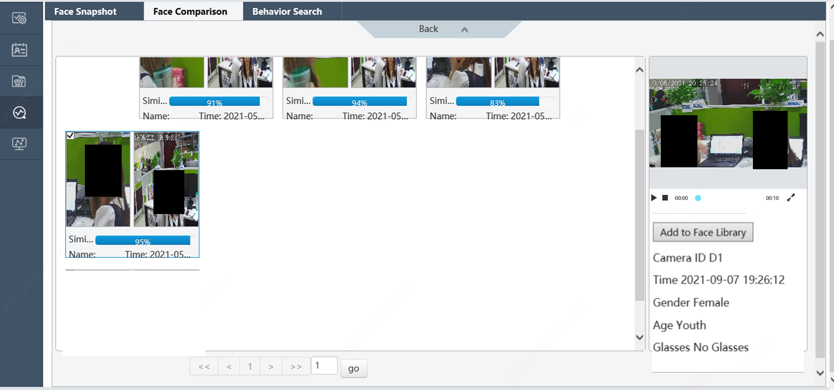
Built-in Web client application
Face recognition record search

Slide 22
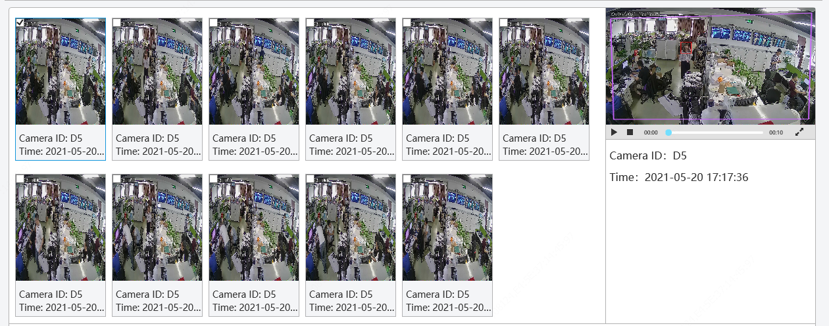
Built-in Web client application
Behavior record search

Slide 23
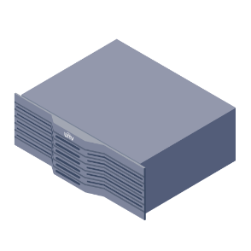
Typical application
Monitor
Target appears
IPC
UNV NVR
IPC
Switch
Video stream
IPC
UNV VMS (B180, Unicorn)/ Third party VMS
AI Box Intelligent analysis
Third party VMS: Provide a complete API for third-party VMS access development.
B180 and Unicorn have completed the matching, a temporary version is available now.

Slide 24
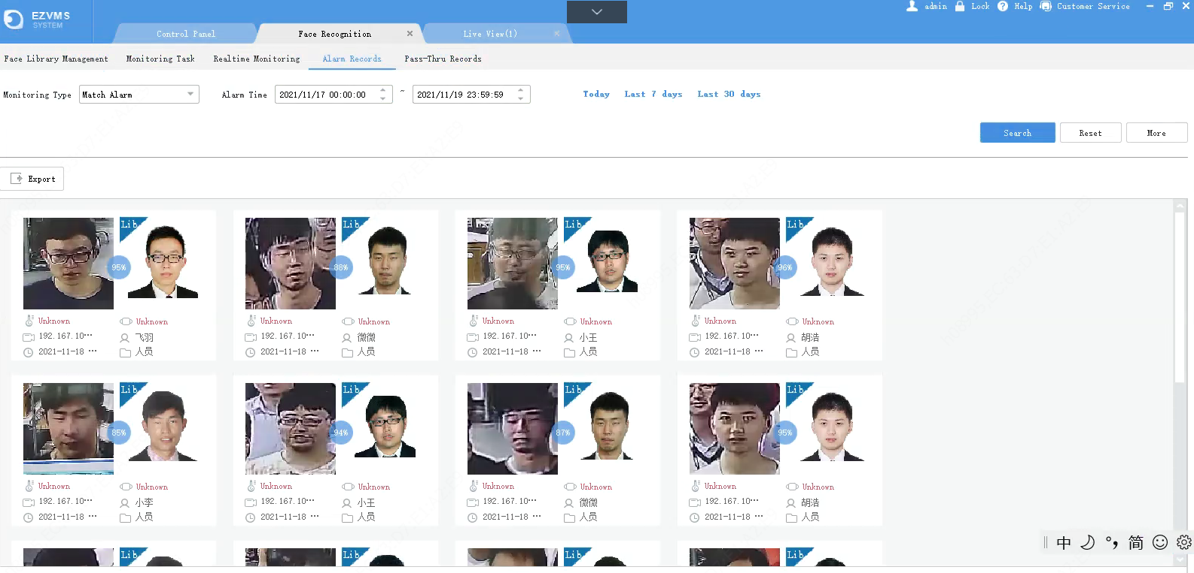
VMS Client – Face recognition
Face recognition

Slide 25
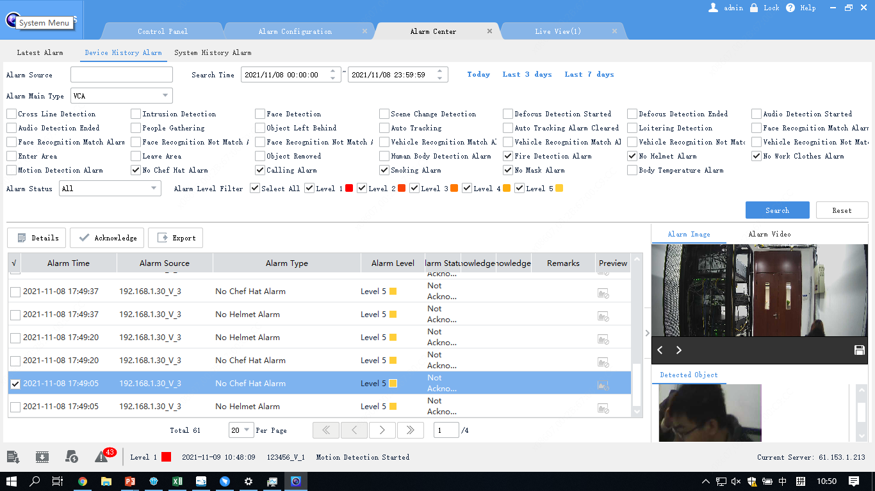
VMS Client – Behavior analysis
Alarm Center
Alarm type
VCA
Intelligent functions supported by AI BOX
Export alarm log
Alarm image & Alarm video

Slide 26
Typical Application
Monitor
IPC
Target appears
UNV NVR
IPC
Switch
Video stream
IPC
EZStation
AI Box Intelligent analysis
Development of this application is expected to be completed in 2022

Slide 27
Cooperation Methods
Face recognition algorithm
Behavior analysis algorithms
AI BOX has built-in face recognition algorithm+ 12 behavior analysis algorithms, provides API interfaces and connects with third-party platforms or SaaS vendors
API
SaaS
Interfacing with third-party platforms or SaaS vendors
API provided by UNV can realize the interaction of data such as video, voice, alarm, picture, device information, etc., applications with strong industry attributes can be achieved.

Slide 28
Matching products
Function | Web | B180/Unicorn | EZstation | Third party software
Face recognition | ✓ | ✓ | developing | Develop according to the API
No face mask detection | ✓ | developing | developing
Smoking detection | ✓ | developing | developing
Calling detection | ✓ | ✓ | developing
No helmet detection | ✓ | ✓ | developing
Fire detection | ✓ | developing | developing
No work clothes detection | ✓ | ✓ | developing
People counting | ✓ | developing | developing
Falling detection | ✓ | developing | developing
Heat map | ✗ | developing | developing
Perimeter | ✓ | developing | developing
Long stay/ Loitering | ✓ | developing | developing
Off duty detection | ✓ | developing | developing

Slide 29
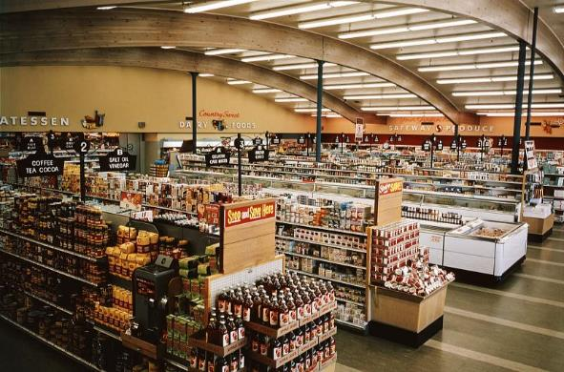
Application scenario
Supermarket
Petrol station
Factory
Bank

Slide 30
Supermarket
Shopping area
People counting
Falling detection
Long stay detection
Warehouse
Perimeter
Entrance
No face mask detection
Perimeter
Face Recognition

Slide 31
Bank
Lobby
People counting
Gate
Perimeter
Face Recognition
Road
Fire detection
Office
Off duty detection
Calling detection

Slide 32
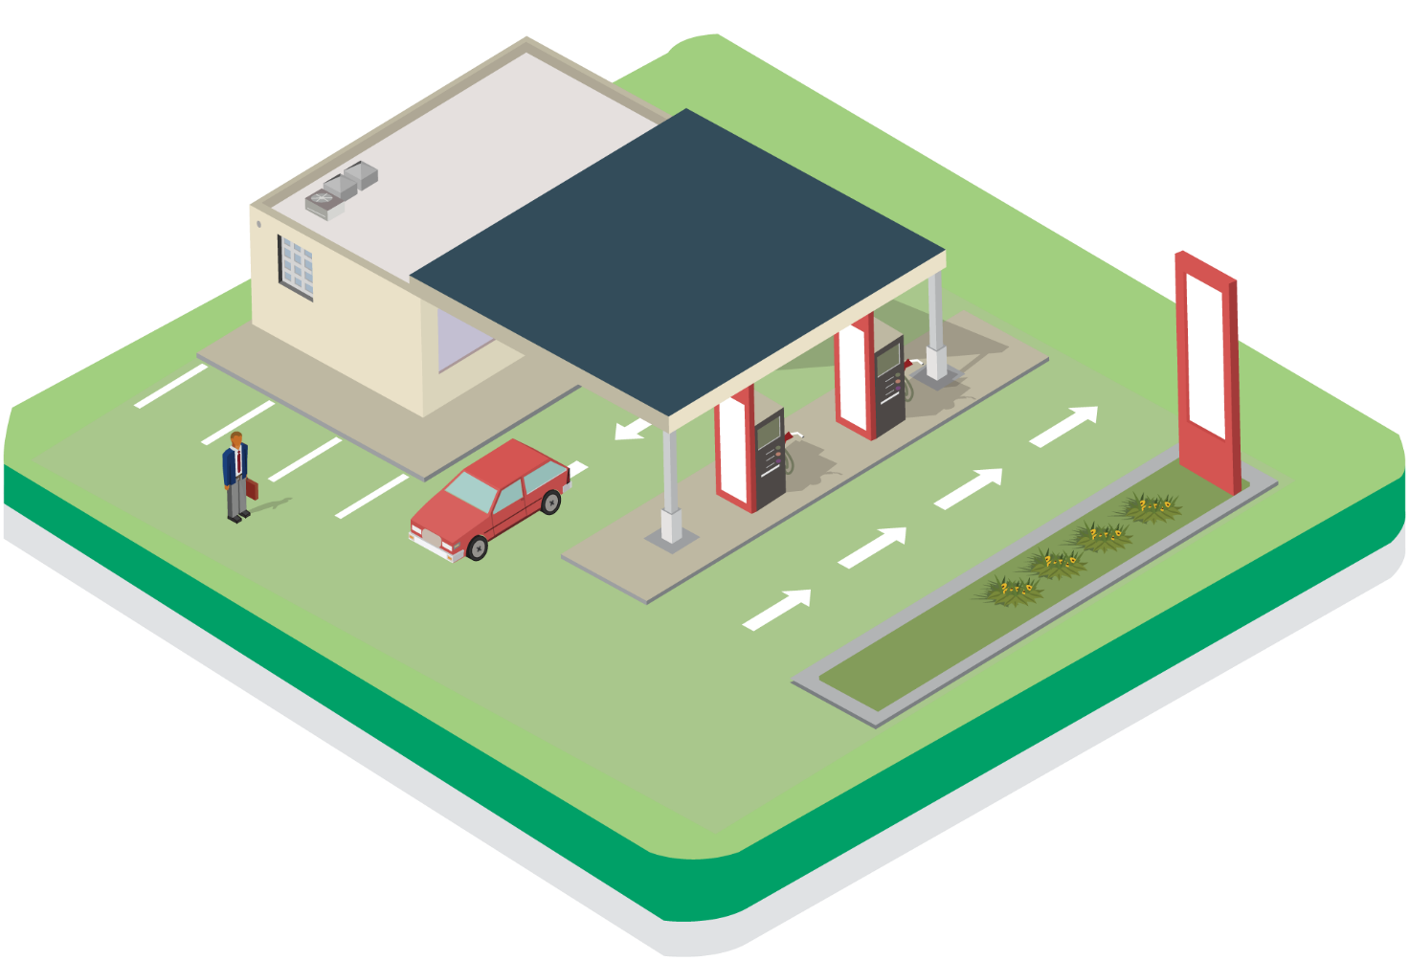
Petrol station
Pump
Fire detection
Calling detection
Auxiliary areas
Smoking detection
Calling detection
Work clothes detection

Slide 33
Factory
Staff management
Work clothes detection
No helmet detection
Warehouse
Fire detection
Face recognition

Slide 34
05
Q&A

Slide 35
Q&A
01
Q：How many AI BOX models have been launched in International markets?
A：Altogether 4:
Model Name | Description | Face library capacity | Video stream based face recognition | Video stream based behavior analysis | BOM | No Brand BOM
ECS-5008@A1 | 8-channel Intelligent Edge Computing Server | 128 face libraries, total 100,000 face images | 8-ch | 8-ch (cannot be enabled simultaneously with face recognition) | 0235C5WQ | 0235C5WY
ECS-5004@A1 | 4-channel Intelligent Edge Computing Server | 128 face libraries, total 100,000 face images | 4-ch | 4-ch (cannot be enabled simultaneously with face recognition) | 0235C5WT | 0235C5WX
ECS-5008@A1-HD | 8-channel Intelligent Edge Computing Server-Including HDD | 128 face libraries, total 100,000 face images | 8-ch | 8-ch (cannot be enabled simultaneously with face recognition) | 0235C5WR | 0235C5X0
ECS-5004@A1-HD | 4-channel Intelligent Edge Computing Server-Including HDD | 128 face libraries, total 100,000 face images | 4-ch | 4-ch (cannot be enabled simultaneously with face recognition) | 0235C5WS | 0235C5X1
Q：What is the difference between AI BOX with HDD and without HDD?
A：The capacity of HDD is 1T, which can store 10s of alarm video.
If it is a AI BOX without HDD, only the alarm log is available.
The hard drive comes with the factory and cannot be replaced.
02
Q：What functions are available now?
A：Face recognition(Face snapshot), No helmet detection, No chef hat detection,
No work clothes detection, Smoking detection, Fire detection,
Calling detection, No mask detection, and Rat detection.
03

Slide 36
Q&A
Q：Behavior analysis cannot be enabled simultaneously with face recognition?
A： Yes
The same device can only use the face recognition function
or the other 8 behavior analysis functions.
Optimization can be completed in January 2022
04
Q：What should I do if I need new function algorithm?
Can some of the original functions be replaced?
A：Please contact the product department for evaluation.
05
06
Q：Does AI BOX have an User interface?
A：No, it only supports viewing on the web.
Q：Does AI BOX have any requirements for the selection of IPC?
A：There are no special requirements.
07

Slide 37
Better Security, Better World

